Slide 1
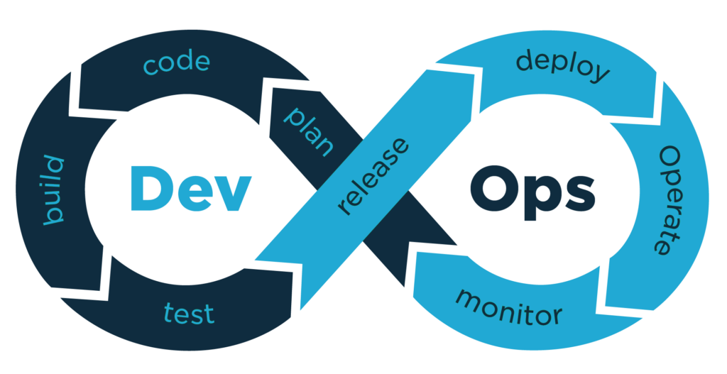
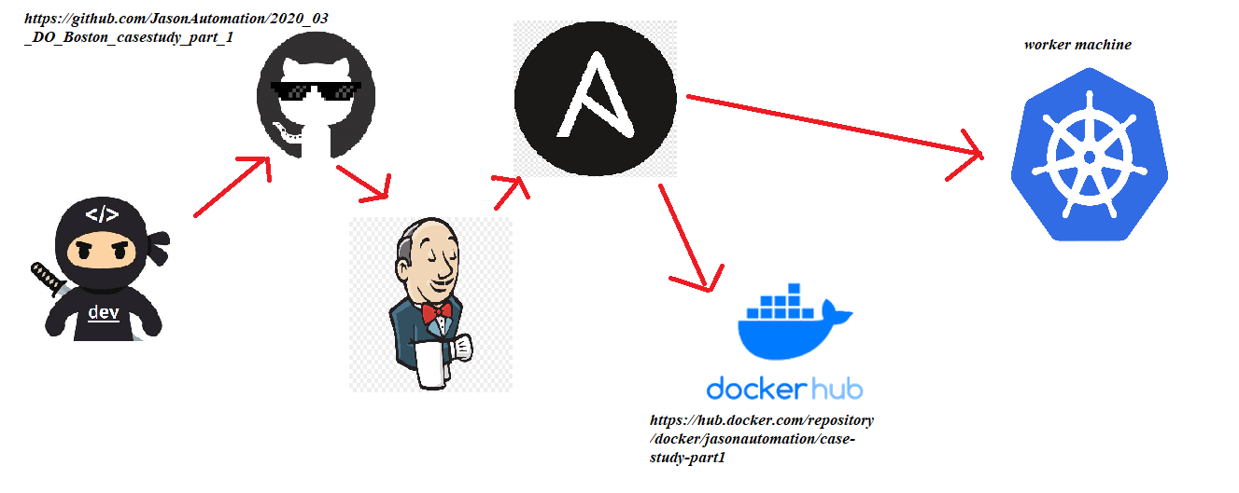
DevOps Pipeline
Jason Kirkcaldy

Slide 2
Planning
The goal of this project is to complete a pipeline which will automatically deploy and scale a flask application.
Outline of steps to be taken:
Create VM1
Install Jenkins and Ansible
Install Ansible plugin and configure installation path
Clone github
Create requirements.txt file
Run flask app locally
Create Dockerfile to build docker image and push to dockerhub - jasonautomaton/case-study-part1
Create Kubernetes yaml file to build cluster with 3 replicas and run locally to test
Create ansible playbook to initiate build on target machine
Create VM2

Slide 3
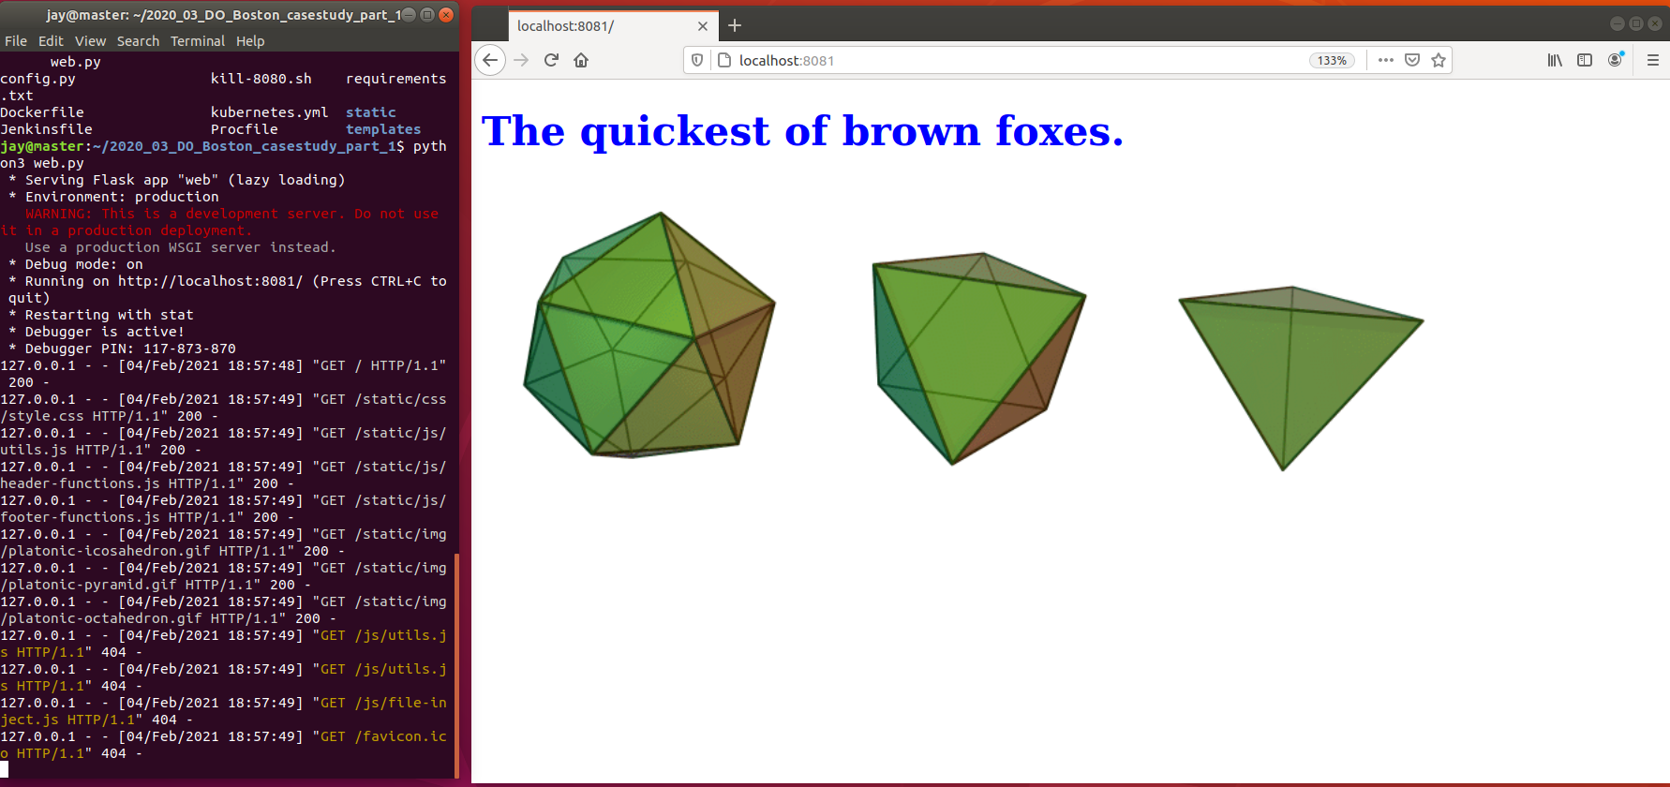
Flask app running locally on port 8081

Slide 4
ASSETS
Install steps:
Create VM1
Install and setup Jenkins
Install ansible plugin and configure installation path
Clone github forked github repo
Create requirements.txt file
Run flask app locally
Create Dockerfile to build docker image and push to dockerhub - jasonautomaton/case-study-part1
Create Kubernetes yaml file to build cluster with 3 replicas and run locally to test
Create ansible playbook to initiate build on target machine
Virtual machine 1: - Jenkins - Ansible - Docker -Git Virtual machine 2: - Docker - Minikube

Slide 5
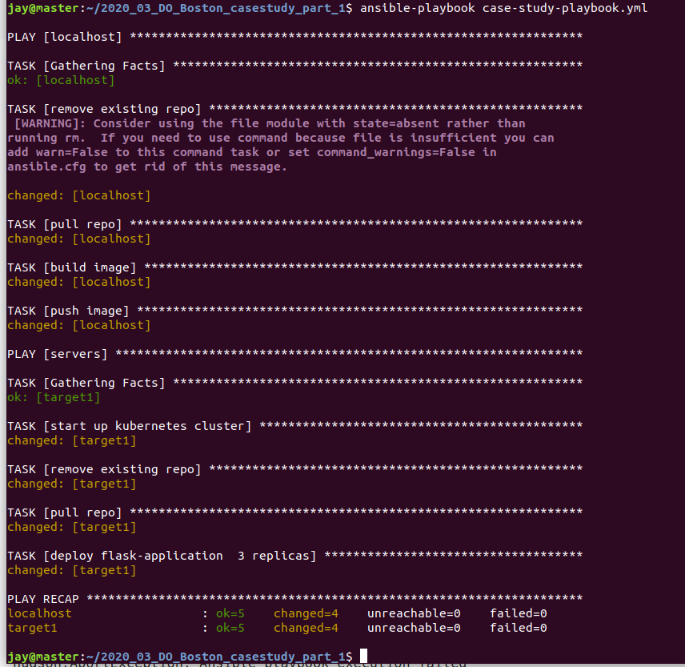
Ansible playbook running from VM1 to target VM2
Pulls github repo (https://github.com/JasonAutomation/2020_03_DO_Boston_casestudy_part_1)
Builds docker image with dockerfile
Pushes docker image to my dockerhub repo: jasonautomation/case-study-part1
SSH’s into target VM
Starts minikube
Removes existing repo
Clones latest repo
Deploys application

Slide 6
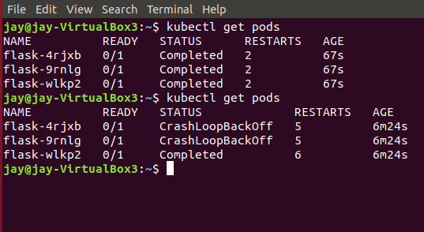
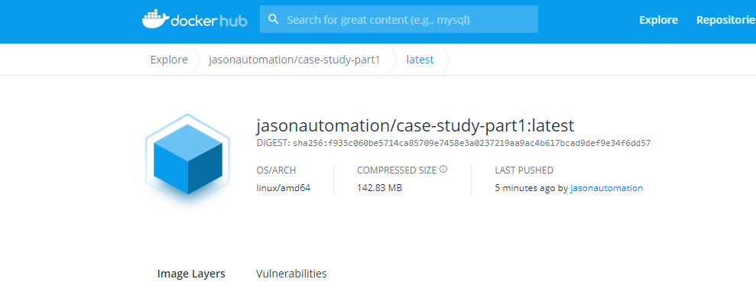
Ansible playbook results:
Current issue with minikube pods
Successfully pushes image to dockerhub

Slide 7
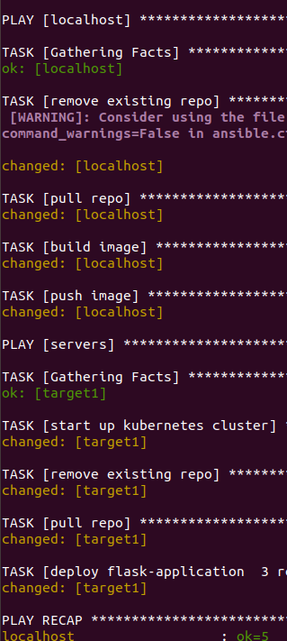
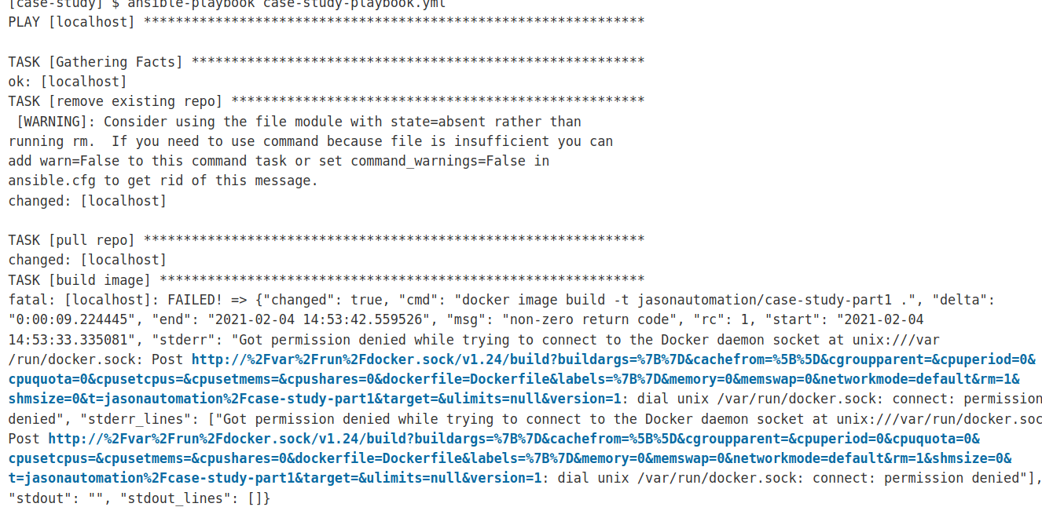
Ansible playbook ran from jenkins

Slide 8
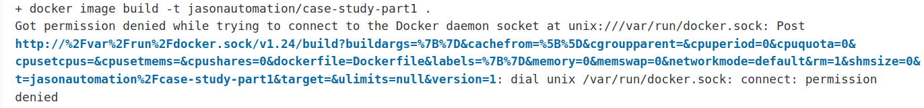
First tried running “usermod -aG docker Jenkins” to add the user Jenkins to the docker group. This did not solve my problem. Running “chmod 777 /var/run/docker.sock” solved this issue, although I am not sure if this is the best way of solving it. Error: couldn’t find any revision to build. Verify the repository and branch configuration for this job. (solved by changing default branch name to master) This was resolved by renaming my github default branch from “main” to “master”.
Issues – resolved

